Slide 1
Protein structure prediction
Siddhartha Jain

Slide 2
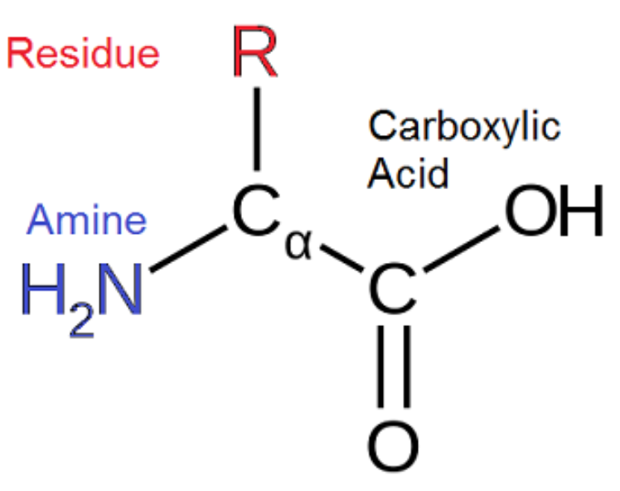
Amino acid structure

Slide 3
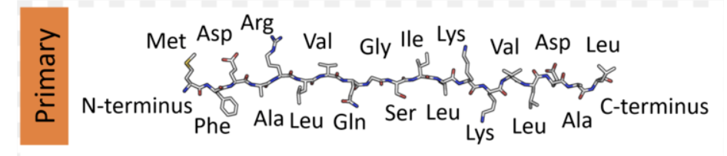
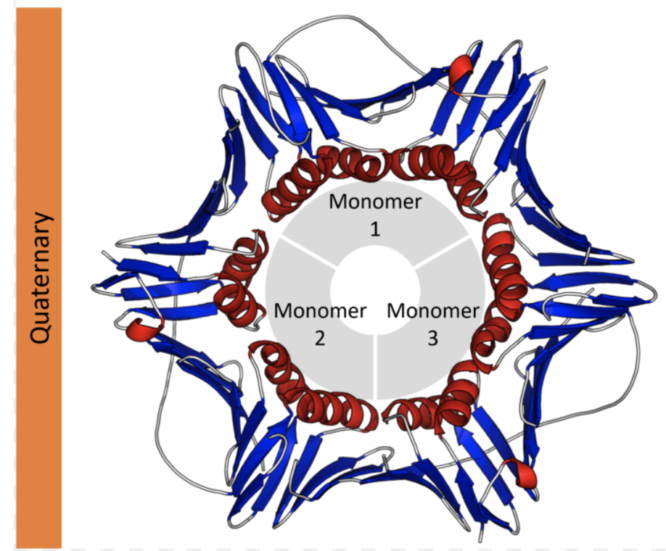
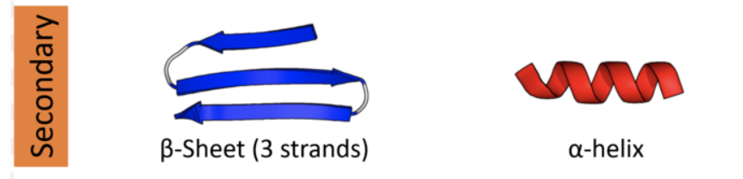
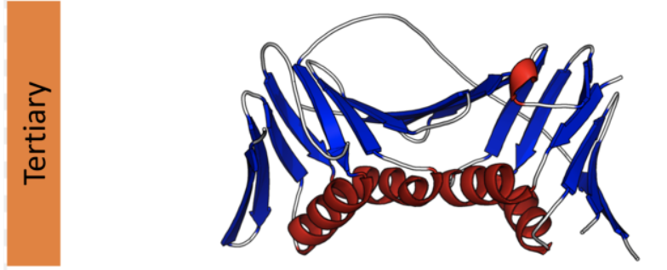
4 levels of protein structure

Slide 4
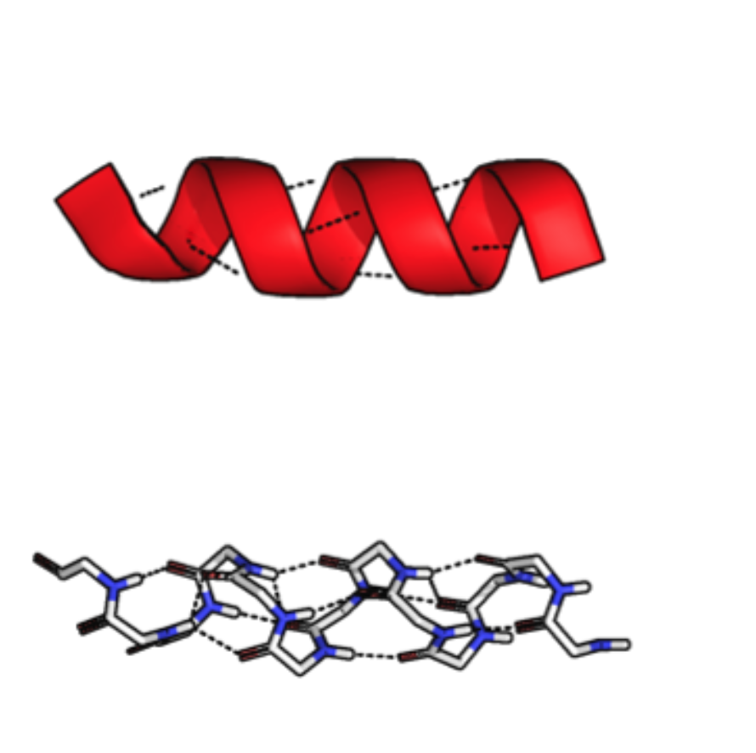
Protein secondary structural motifs
Alpha helices
Each AA corresponds to 100 degree turn in helix and translation of 1.5 angstroms

Slide 5
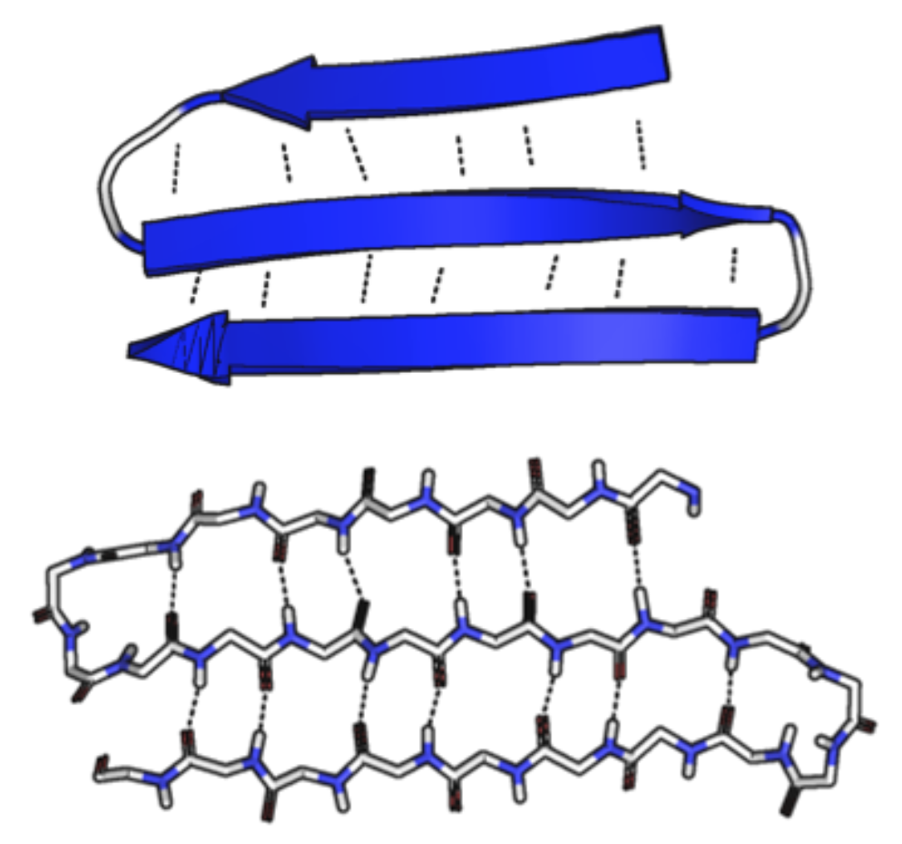
Protein secondary structural motifs
Beta sheets
Composed of beta strands hydrogen bonded together
Participating strands don’t have to be close in the primary sequence

Slide 6
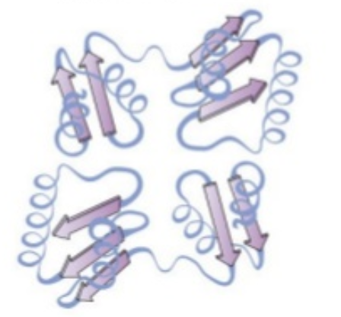
Protein secondary structural motifs
Turns
Allow polypeptide chain to change direction
Classified according to various criteria (# of residues, bonding, etc.)
Usually have 4-5 residues
Loops
Any irregular/unclassified turns

Slide 7
Structure prediction strategies
Molecular dynamics
Energy function minimization

Slide 8
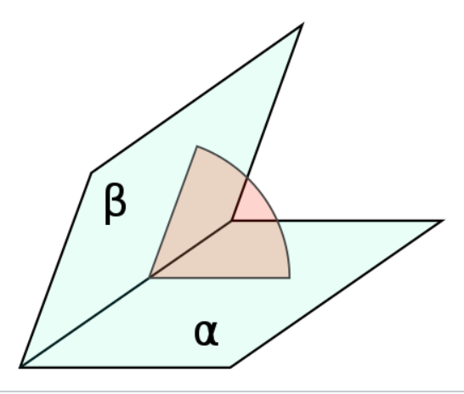
Protein representation
Cartesian space
X, Y, Z coordinates
Torsion (internal coordinate) space
Bond length (2 atoms), Bond angle (3 atoms), Torsion/Dihedral angle (4 atoms)
Notes:
Advantages
Highly parallelizable
Small changes in coordinates likely lead to small changes in energy – easy to prevent steric clashes
Disadvantages
Harder to maintain bond length, bond angle, dihedral angle constraints (local geometry)
Advantages
Easy to maintain local geometry
Energy functions usually characterized in these parameters
Disadvantanges
Harder to parallelize
Small changes can lead to big structural changes

Slide 9
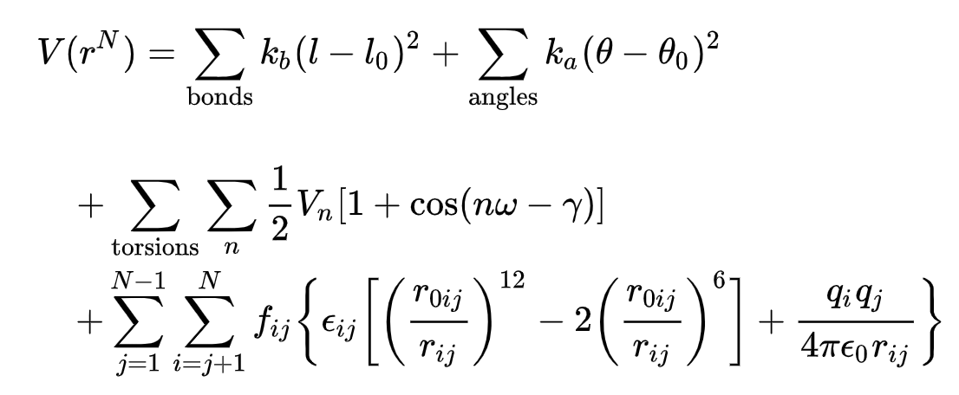
Amber energy function

Slide 10
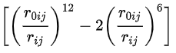
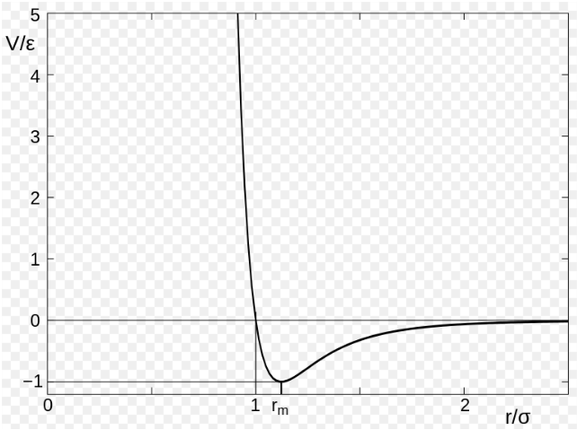
Lennard Jones potential

Slide 11
Strategies for protein folding
Rosetta (Template based structure search)
AlphaFold (by DeepMind)

Slide 12
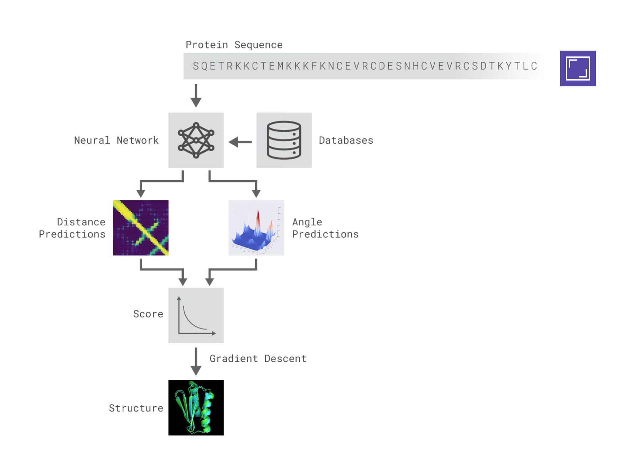
AlphaFold

Slide 13
Features
Multiple Sequence Alignment (MSA) features
Have coevolutionary information
VERY IMPORTANT – on contact prediction, performance drops from 50% to 13% without them!
Sequence features

Slide 14
Coevolutionary constraints
Homologs of proteins are identified
Multiple sequence alignment (MSA) is done
Coevolutionary restraints are identified

Slide 15
Main idea
Predict a distribution of inter-residue distances and bond angles (distance take with respect to alpha carbon of residue)
Trained via cross entropy loss
They call it distogram

Slide 16
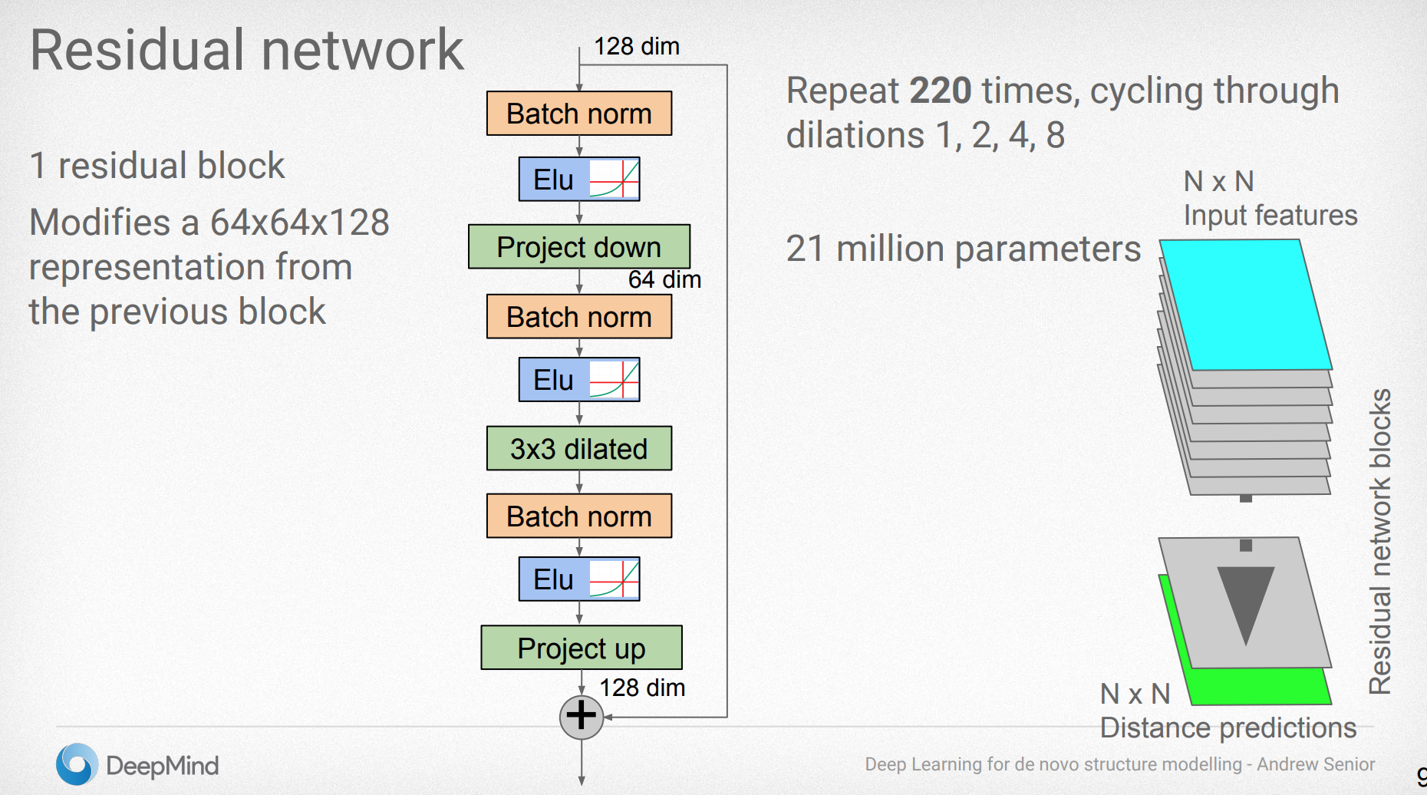

Slide 17
Structure generation
Just do gradient descent which works very well!
Score function for gradient descent is (Statistical potential + Torsion likelihood + Rosetta energy function)

Slide 18
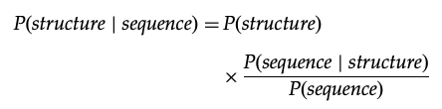
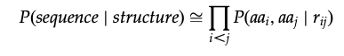
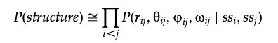
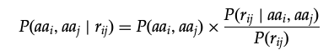
Statistical potential

Slide 19
Learn statistical potential likelihood
Learn a potential function to assign a potential to every state (based on just inter-residue distances as features)
Normalize potential function with respect to a reference state
Based on location of residues and protein length
Is learnt from data

Slide 20
Final scoring network
Use distogram, contact map based on distogram, and MSA features to predict GDT distribution
Use this network to select between final set of structures

Slide 21
Evaluation criterion
Root mean square deviation (RMSD)
Sensitive to outlier regions created by poor modeling of individual loop regions
Global distance test (GDT TS)
Largest set of AA’s alpha carbon atoms falling within a defined distance cutoff of their position in the experimental structure

